Slide 1
Online Retail Segmentation Project Author: Ashfaq
High Impact Skills Development Program - AI & Data Science

Slide 2

introduction
Project Overview:
This project focuses on customer segmentation in an online retail environment using SQL queries to analyze purchasing behaviors.
Objectives:
Understand the fundamentals of data mining.
Learn SQL- based data mining implementation.
Analyze customer segmentation for actionable insights.
Tools Used:
MySQL Workbench, SQL queries, GitHub for version control.

Slide 3
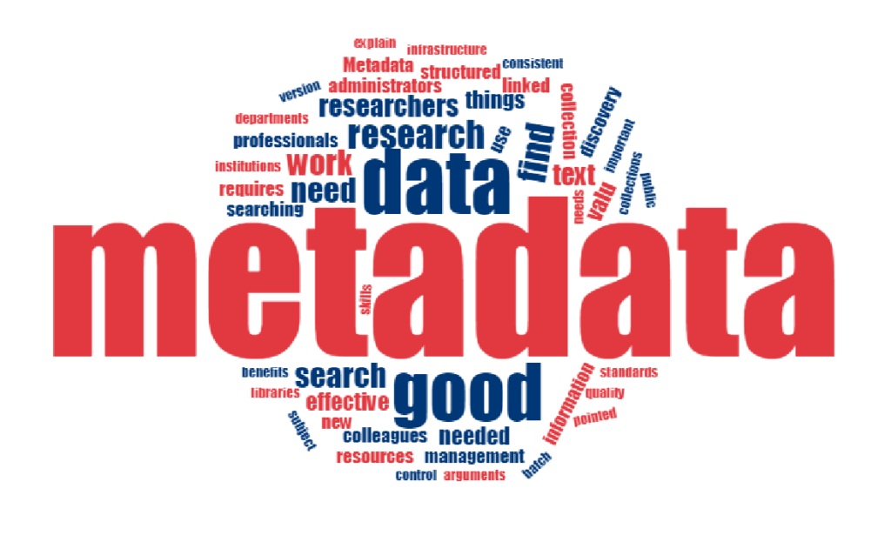
Online Retail Dataset Overview
Metadata:
The dataset contains transaction records from an online retail store, with variables such as InvoiceNo, StockCode, Description, Quantity, UnitPrice, CustomerID, and Country.
Key Variables:
InvoiceNo: Unique invoice identifier. StockCode: Product code. Description: Product description. Quantity: Number of units sold. UnitPrice: Price per unit. CustomerID: Unique customer identifier. Country: Customer location.
Purpose of Data:
This data helps in customer behavior analysis and segmentation by evaluating purchase patterns across different regions and product categories.

Slide 4
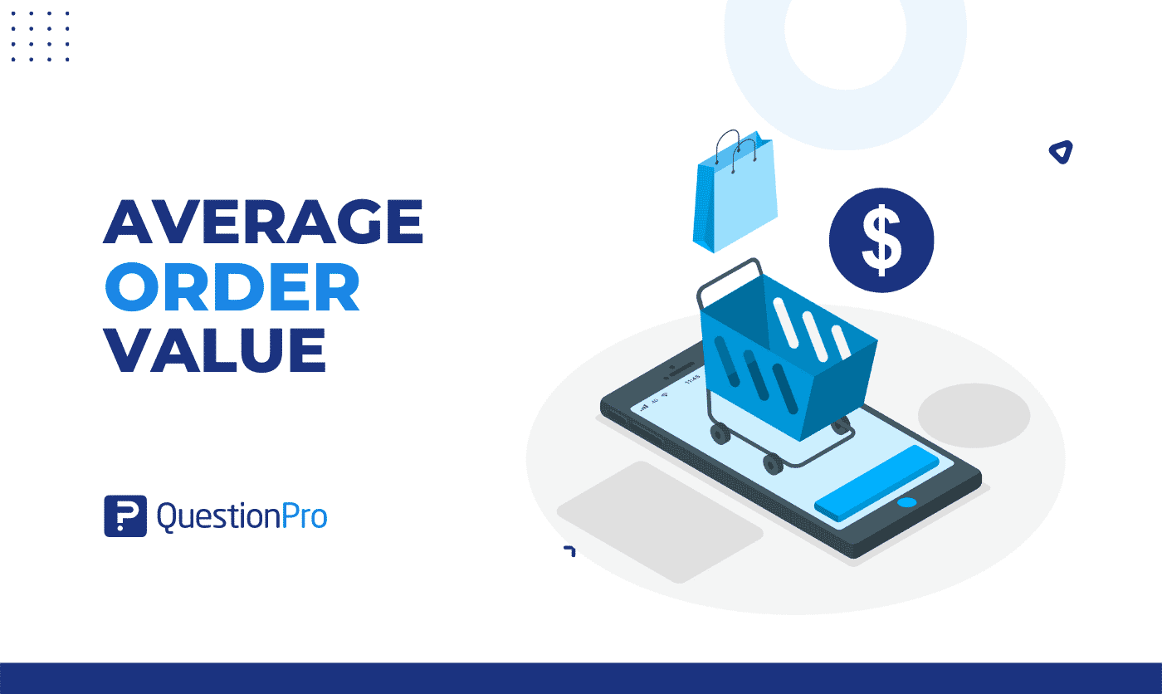
Basic Query 1: Order Value Distribution
Calculating Total Order Value for Each Customer
Query Purpose:
Calculate the total order value for each customer to understand who are the high and low spenders.
Business Insight:
This query helps businesses understand which customers contribute most to revenue, enabling targeted marketing strategies.
SQL Query:
SELECT CustomerID, SUM(UnitPrice * Quantity) AS Total OrderValue FROM Online_Retail GROUP BY CustomerID ORDER BY Total OrderValue DESC;
Query Explanation
The query calculates total sales value per customer by multiplying the unit price with the quantity of products bought. Grouping by CustomerID, it sums the order values, showing the highest spenders first.

Slide 5
Basic Query 2: Unique Products Purchased
Counting Unique Products Purchased by Each Customer
Query Purpose:
Count the distinct number of products purchased by each customer to identify customer preferences.
SQL Query:
SELECT CustomerID, COUNT(DISTINCT StockCode) AS UniqueProducts FROM Online_Retail GROUP BY CustomerID ORDER BY Unique Products DESC;
Business Insight:
Helps businesses understand customer preferences and product diversity, aiding in personalized marketing.
Query Explanation:
This query counts distinct StockCode values per customer to determine how many unique products they have purchased. It groups the data by CustomerID and orders the result by the count of unique products.

Slide 6
Basic Query 3: Single Purchase Customers
Identifying One-Time Customers
Query Purpose:
Identify customers who have made only one purchase to target them for retention strategies.
SQL Query:
SELECT CustomerID, COUNT(InvoiceNo) AS PurchaseCount FROM Online_Retail GROUP BY CustomerID HAVING COUNT(InvoiceNo) = 1;
Business Insight:
Helps businesses identify single-purchase customers for re-engagement efforts to increase customer retention.
Query Explanation:
This query counts how many times each customer has made a purchase, returning only customers with exactly one purchase using the HAVING clause.

Slide 7
Basic Query 4: Most Frequently Purchased Products
Top 5 Most Purchased Products
Query Purpose:
Identify the top 5 most frequently purchased products to focus on popular items.
SQL Query:
SELECT StockCode, COUNT(*) AS Frequency FROM Online_Retail GROUP BY Stock Code ORDER BY Frequency DESC LIMIT 5;
Business Insight:
Helps businesses understand which products are in high demand, aiding in inventory management and marketing focus.
Query Explanation:
This query groups transactions by StockCode, counts how often each product appears, and returns the top 5 based on frequency. The LIMIT clause restricts the output to the 5 most popular products.

Slide 8
Advanced Query 1: Purchase Frequency Segmentation
Segmenting Customers by Purchase Frequency
Query Purpose:
Segment customers into High, Medium, and Low frequency based on their purchase counts.
SQL Query:
SELECT CustomerID, COUNT(InvoiceNo) AS Purchase Frequency, CASE WHEN COUNT(InvoiceNo) > 10 THEN 'High' WHEN COUNT(InvoiceNo) BETWEEN 5 AND 10 THEN 'Medium' ELSE 'Low' END AS FrequencySegment FROM Online_Retail GROUP BY CustomerID;
Business Insight:
Helps businesses identify loyal customers and those who need more engagement, targeting based on frequency.
Query Explanation:
The query counts the number of purchases per customer and categorizes them into frequency segments: High, Medium, and Low using a CASE statement.

Slide 9
Advanced Query 2: Average Order Value by Country
Analyzing Sales Across Different Countries
Query Purpose:
Calculate the average order value for each country to identify high-revenue markets.
Business Insight:
Helps businesses identify which countries have the highest average order values, guiding international marketing strategies.
SQL Query:
SELECT Country, AVG(UnitPrice * Quantity) AS AverageOrderValue FROM Online_Retail GROUP BY Country ORDER BY Average OrderValue DESC;
Query Explanation:
This query multiplies UnitPrice by Quantity to get the total value for each order, then groups by Country and calculates the average order value for each country.

Slide 10
ADVANCED Query 3: Customers Without Recent Purchases
Identifying At-Risk Customers
Query Purpose:
Identify customers who haven't made a purchase in the last 6 months to prevent churn.
SQL Query:
SELECT CustomerID FROM Online Retail WHERE InvoiceDate < DATE_SUB(NOW(), INTERVAL 6 MONTH) GROUP BY CustomerID;
Business Insight:
Identifies customers at risk of churn, allowing businesses to re-engage them with targeted offers or campaigns.
Query Explanation:
This query checks if the last purchase date for each customer is more than 6 months ago by comparing InvoiceDate with the current date minus 6 months using DATE_SUB.

Slide 11
Advanced Query 4: Product Affinity Analysis
Identifying Frequently Purchased Product Pairs
Query Purpose:
Identify products frequently purchased together by analyzing product pair co-occurrence.
SQL Query:
SELECT a.StockCode AS ProductA, b.StockCode AS ProductB, COUNT(*) AS Frequency FROM Online_Retail a JOIN Online_Retail b ON a.InvoiceNo = b.InvoiceNo AND a.StockCode <> b.StockCode GROUP BY a. StockCode, b.StockCode ORDER BY Frequency DESC LIMIT 10;
Business Insight:
Helps businesses identify product bundling and cross- selling opportunities by finding product pairs often bought together.
Query Explanation:
The query joins the same table on InvoiceNo, grouping by StockCode pairs and counting how often different products appear together in the same transaction.

Slide 12
Advanced Query 5: Monthly Sales Trends
Analyzing Sales Trends Over Time
Query Purpose:
Analyze monthly sales patterns to identify trends and seasonality.,
SQL Query:
SELECT YEAR(InvoiceDate) AS Year, MONTH(InvoiceDate) AS Month, SUM(UnitPrice * Quantity) AS TotalSales FROM Online_Retail GROUP BY YEAR(InvoiceDate), MONTH(InvoiceDate) ORDER BY Year, Month:
Business Insight:
Helps businesses understand trends in customer behavior, identifying peaks and slumps for better forecasting.
Query Explanation:
This query groups sales data by year and month. calculating total sales for each month to provide insights into seasonal and time-based sales patterns.

